Slide 1

Data Structures and Algorithms: Approximations
Notes, Chapter 35, CLRS

Slide 2
Outline
Not everything is efficiently solvable exactly.
This means that sometimes you have to either
Approximate
Use a theoretically slow method to find the optimal solution that seems to work quickly most of the time
These strategies fall into three classes
Intelligent exhaustive search for optimal solution
Find an approximately optimal solution
Find a solution and use “local heuristics” to improve it

Slide 3
Intelligent Exhaustive Search
Two common methods
Backtracking
Branch-and-bound
We discussed these under the auspices of Search when we covered Chapter 3 of Poole.

Slide 4
Approximation Algorithms
Idea: Give up on the idea of finding optimal solution
You may get lucky and get the optimal solution with an approximation, but you won’t know if you did or not
Plan: Use an algorithm that gives an answer
Bonus if you can prove that the answer is within a certain % of optimal
Approximation ratio is the ratio of the cost C(n) of an approximate solution relative to the cost C*(n) of an optimal solution. For a maximization problem:

Slide 5
Goodness of Approximation
Sometimes you can prove a worst case on how good an approximation is.
A ρ-approximation is guaranteed to be no more than ρ times the cost of an optimal solution.
A ρ(n)-approximation is an approximation in which the goodness of the approximation varies with the problem size.

Slide 6
Some Greedy Approximation Algorithms
I will discuss three problems for which there are fast, greedy approximation algorithms.
All these problems are what’s known as “NP-complete”
There are no known polynomial time algorithms to give an optimal solution the any of these problems.

Slide 7
Vertex Cover
Recall that a vertex cover (VC) of size k of a graph is a subset of k nodes such that every edge is incident on at least one node in the cover.
Note that you’re covering all the edges with a set of nodes.

Slide 8
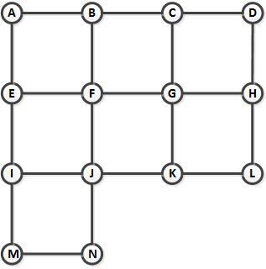
Vertex Cover
For example, imagine a set of straight streets, with security cameras at intersections. Assume that a security camera can see all the way to the next intersection, and can swivel 360º.

Slide 9
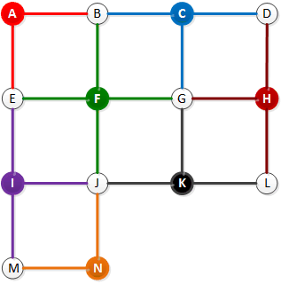
Vertex Cover
A VC for this set of streets is a subset of intersections where you could focus at least one camera on every street, with a camera at each intersection in the VC.

Slide 10
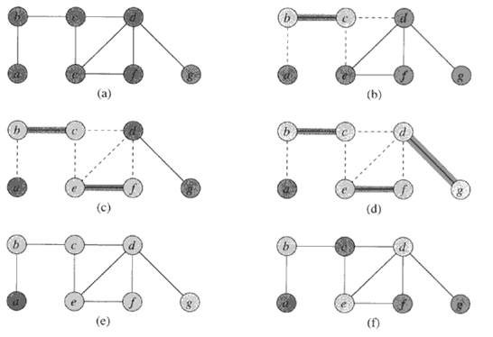
Vertex Cover – Greedy Algorithm
Pick an edge, and put both its vertices into the cover. Then delete all other covered edges and repeat.

Slide 11
Approx-Vertex Cover Pseudocode
Approx-Vertex-Cover(G) {
C = ∅
E’ = E(G)
while E’ != ∅ {
let (u,v) be an arbitrary edge of E’
C = C ∪ {u,v}
E’ = E’ – any edge incident on u or v
}
return C
}
Running time:
Touch each edge and each vertex once O(V+E)

Slide 12
Theorem/Proof
Th: Approx-Vertex-Cover is a polynomial time 2-approximation algorithm. ρ(n) ≤ 2
First, it’s a vertex cover. Every edge is incident on at least one vertex in the set.
Second, it runs in polynomial time.
The reason that ρ(n) ≤ 2 is that for each edge, in the worst case, you would select both vertices to put in the cover.
In the best possible case, each edge would be covered by exactly one vertex.

Slide 13
Approx Vertex Cover & Maximal Matchings
Matching
Matching: subset of edges with no vertex in common
Maximal matching: Matching in which no more edges can be added
To generate maximal matching:
Pick edges disjoint from chosen ones until no longer possible.
Theorem: any vertex cover must be at least as large as the number of edges in the smallest maximal matching
Proof outline: Any maximal matching has at most one edge adjacent to each vertex, so one of the vertices on each edge must be in the vertex cover.

Slide 14
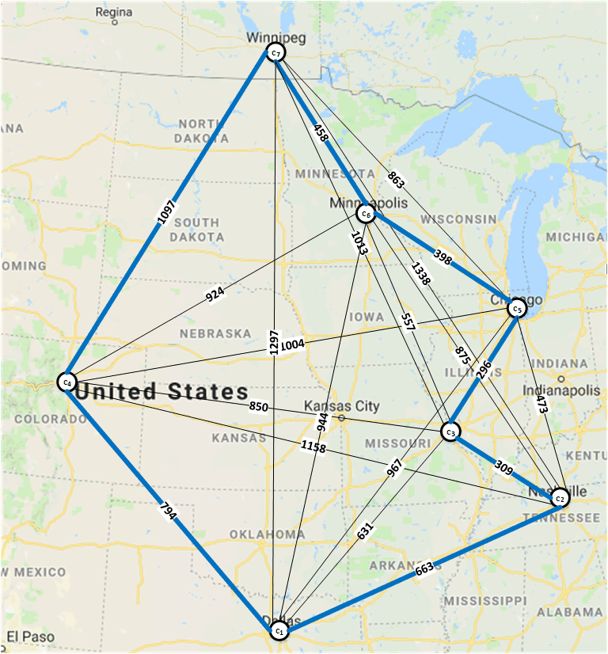
Traveling Salesperson Problem
Recall that the Traveling Salesperson Problem (TSP) is the problem of finding the shortest path to visit all of a set of cities and return home.

Slide 15
TSP is very hard
The best exact solution to the TSP is the Held-Karp algorithm.
It’s a dynamic programming algorithm.
Its running time is O(n*2^{n})
The fastest “good” solution to the TSP is the Lin-Kernighan local search algorithm.
But there is a pretty good greedy approximation.

Slide 16
TSP approximations
Assume the triangle inequality holds
Without this, good approximation can be proven to be very difficult.
We will prove this.
Common TSP approximation is the Minimum Spanning Tree (MST) approximation
The MST is the tree that touches every node with the shortest path.
So if you started at the beginning and travelled down the MST, backtracking at every leaf node, you would travel twice as far as the MST length (MST length is ≤ the minimum TSP distance).

Slide 17
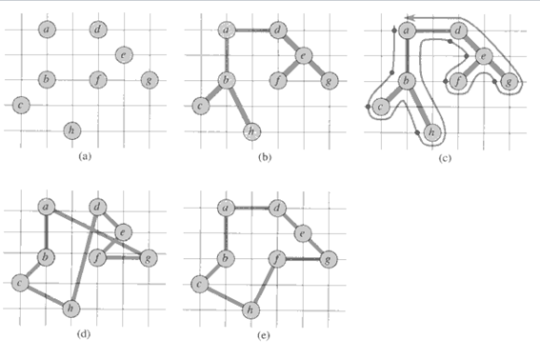
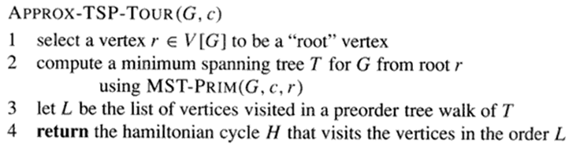
MST approx. to TSP (Approx-TSP-tour)

Slide 18
Approx-TSP-tour
Th: MST-Approx-TSP-Tour is a polynomial time 2-approximation algorithm. ρ(n) ≤ 2
Clearly a TSP tour
Can compute in polynomial time.
Can calculate an MST in polynomial time.
Can do a preorder tree traversal in polynomial time.
If you travelled down the MST, backtracking at every leaf node, you would travel twice as far as the MST distance (which is ≤ the minimum TSP distance).
Skipping nodes can’t make it worse.
So if you visit the nodes in the order you find them in the MST, you will go no more than twice the optimal distance. ρ(n) ≤ 2.

Slide 19
What if Triangle Inequality Doesn’t Hold?
But suppose that we are looking for a tour with a distance metric in which the triangle inequality doesn’t hold.
Example: Finding lowest airfare between two cities.
Th: Unless P = NP, for any constant ρ > 1, there is no polynomial-time approximation algorithm with approximation ratio ρ for the TSP when the triangle inequality doesn’t hold.
We prove this by contradiction, showing that if there were such a ρ-approximation, we could use it to solve the Hamiltonian Cycle problem in polynomial time.
Since the Hamiltonian Cycle problem is NP-C, this means P=NP

Slide 20
Proof
Proof by contradiction
We use a polynomial-time ρ-approximation to solve the Hamiltonian Path Cycle problem in polynomial time.
Suppose there is a ρ-approximation A for the TSP on a graph G.
So this produces a tour that is no more than a factor of ρ more than the shortest (optimal) tour.
Define graph G’ = (V,E’), where E’ is the set of all possible edges
G’ is a complete graph.

Slide 21
Proof (II)
Define the length of each edge as
d(u,v) = 1 if (u,v) ∈ E
d(u,v) = ρ|V| + 1 if (u,v) ∉ E.
Consider TSP on graph G’ with distance function d.
If original graph G contains a ham-cycle, it will correspond to a TSP tour of distance |V| in graph G’.
Because every edge in G’ but not G has distance ρ|V|+1, every TSP tour that uses edges not in original graph G has distance ≥ ρ|V| + 1.

Slide 22
Proof (III)
Now apply algorithm A, which computes a polynomial-time approximation no worse than ρ times the optimal solution, to find a TSP for graph G’.
If it returns a tour with length ≥ ρ|V| + 1, then G has no Hamiltonian cycle, because the algorithm is guaranteed to return a tour with a cost no more than ρ times the optimal tour.
Otherwise it returns a tour of length |V|, meaning that G has a Hamiltonian cycle.

Slide 23
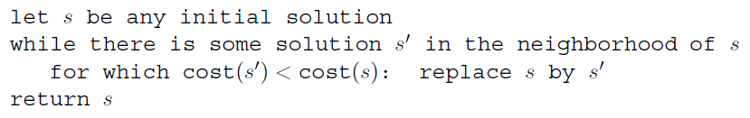
Local Heuristics
General algorithm template
Somehow you find a solution
Then you “tweak” it in a way that would make it better.

Slide 24
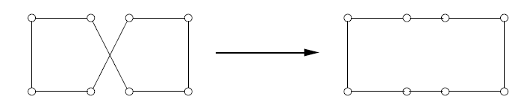
Local Heuristic for TSP
Simple example: If paths ever cross, switch endpoints so that they don’t cross.

Slide 25
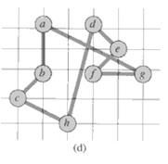
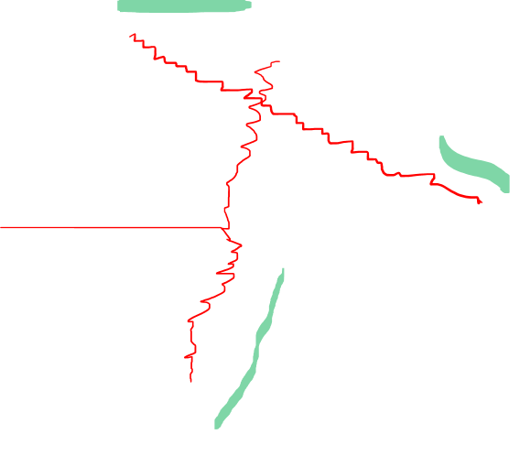
TSP example from before

Slide 26
Set Cover
A set covering problem consists of a set X and a family F of subsets of X, in which every element of X belongs in at least one subset in F.
A subset S ∈ F covers its elements. We want to find the minimum size subset C ⊆ X such that
There’s a greedy algorithm that does this by picking a set to cover the greatest number of uncovered elements.

Slide 27
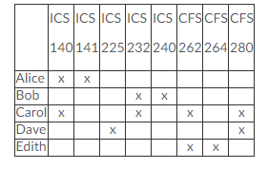
Set Cover Example
X is the set of all courses.
The subsets are the courses each person can tutor.
We want to assign tutors so that every course has someone able to tutor it.

Slide 28
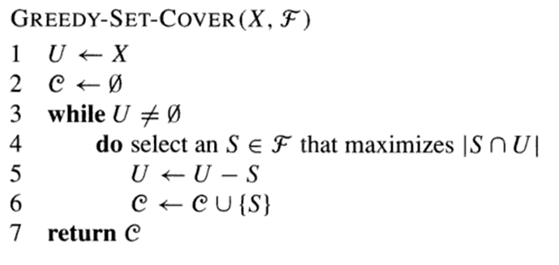
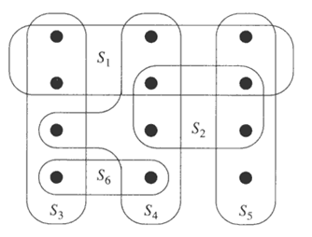
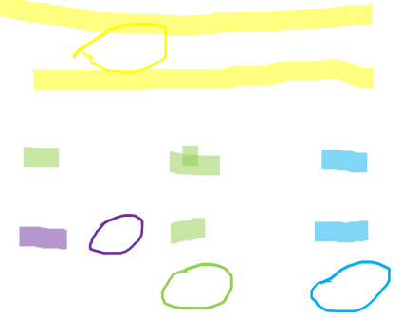
Greedy Set Cover Algorithm
In other words, pick the subset S_{i} that covers the most uncovered elements of X

Slide 29
Greedy Set Cover Properties
Theorem: Greedy-Set-Cover is a polynomial-time ρ(n) approximation algorithm
ρ(|S|) = H(max{|S| : S ∈F }, where
Polynomial time algorithm
Produces a set cover
Proof takes more time than I want to get into.
But ρ(|S|) = ln|S| + 1, so it’s better than a 2-approximation.

